Slide 1
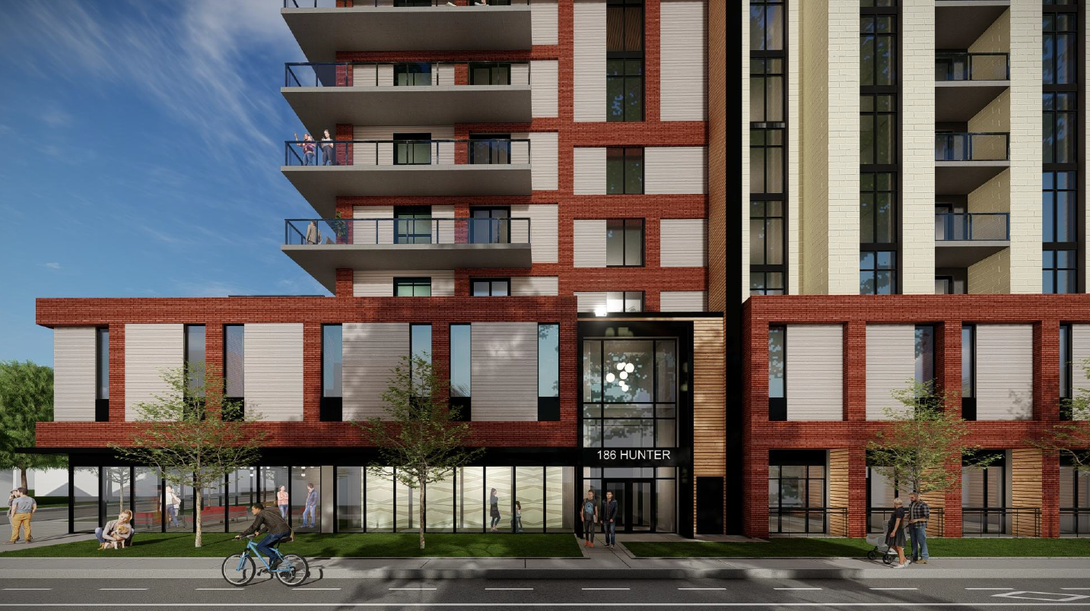

Slide 2
Design Review Panel
Official Plan and Zoning By-law Amendment Applications
186 Hunter Street East, Hamilton
Owner: Wellington Hamilton Non-Profit Housing Inc.
Agent: UrbanSolutions Planning & Land Development Consultants Inc.
April 14th, 2022

Slide 3
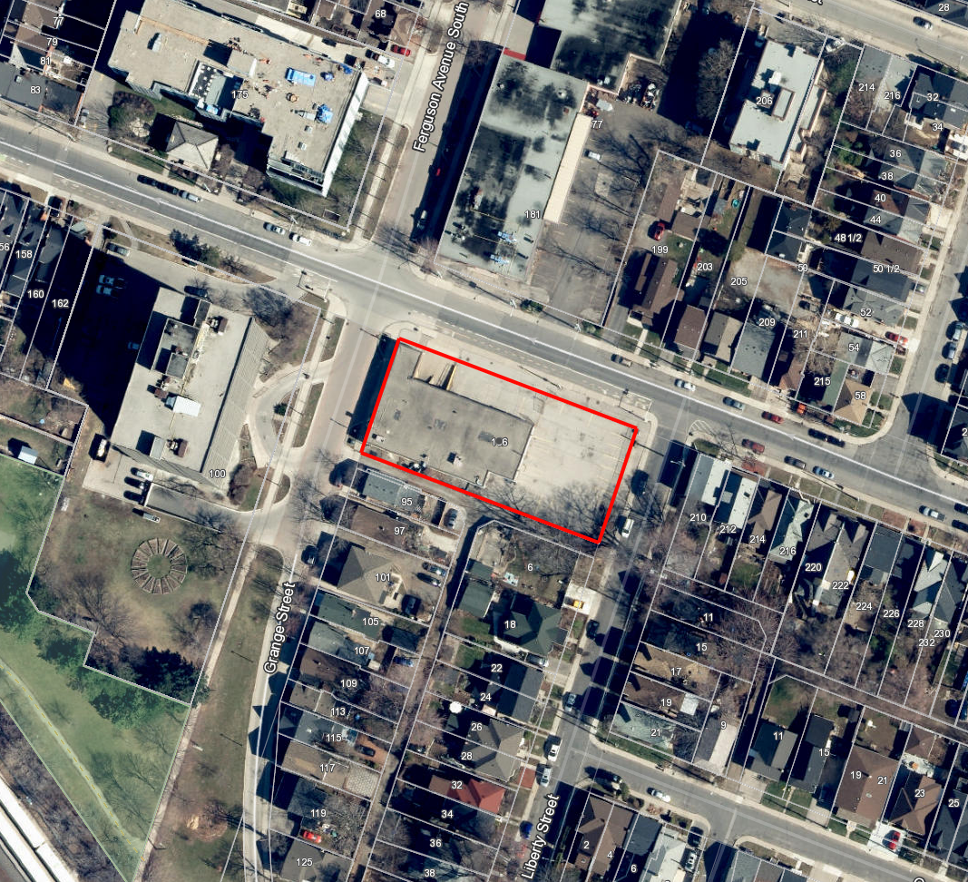
Subject Lands
Location: 186 Hunter Street East between Liberty Street and Ferguson Avenue South in the Corktown Neighbourhood
Size: 0.18 ha (0.43 acres)
Current Use: Lands are currently occupied by vacant 1-storey commercial building.

Slide 4
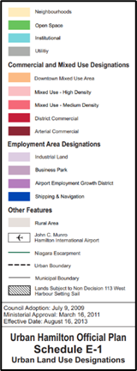
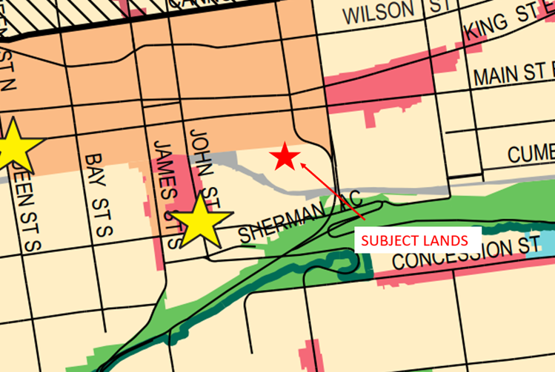
Official Plan Amendment
Designated as ‘Neighbourhoods’
Official Plan Amendment required to allow a residential density of 595 units per hectare which is below the permitted density range of 200 units per hectare in high density residential areas as per Policy E.3.6.6 of the UHOP.
Schedule E-1 - Urban Land Use of UHOP

Slide 5
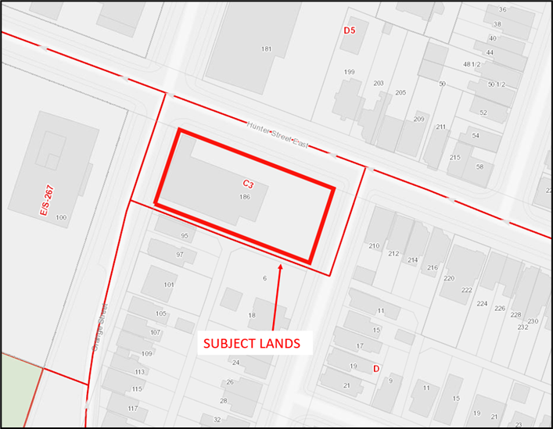
Zoning By-law Amendment
Zoning By-law Amendment required to rezone the subject lands from the Community Commercial (C3) Zone in the City of Hamilton Zoning By-law No. 05-200, to a site specific “E3/S-___” (High Density Multiple Dwellings) District in the City of Hamilton Zoning By-law No. 6593.

Slide 6
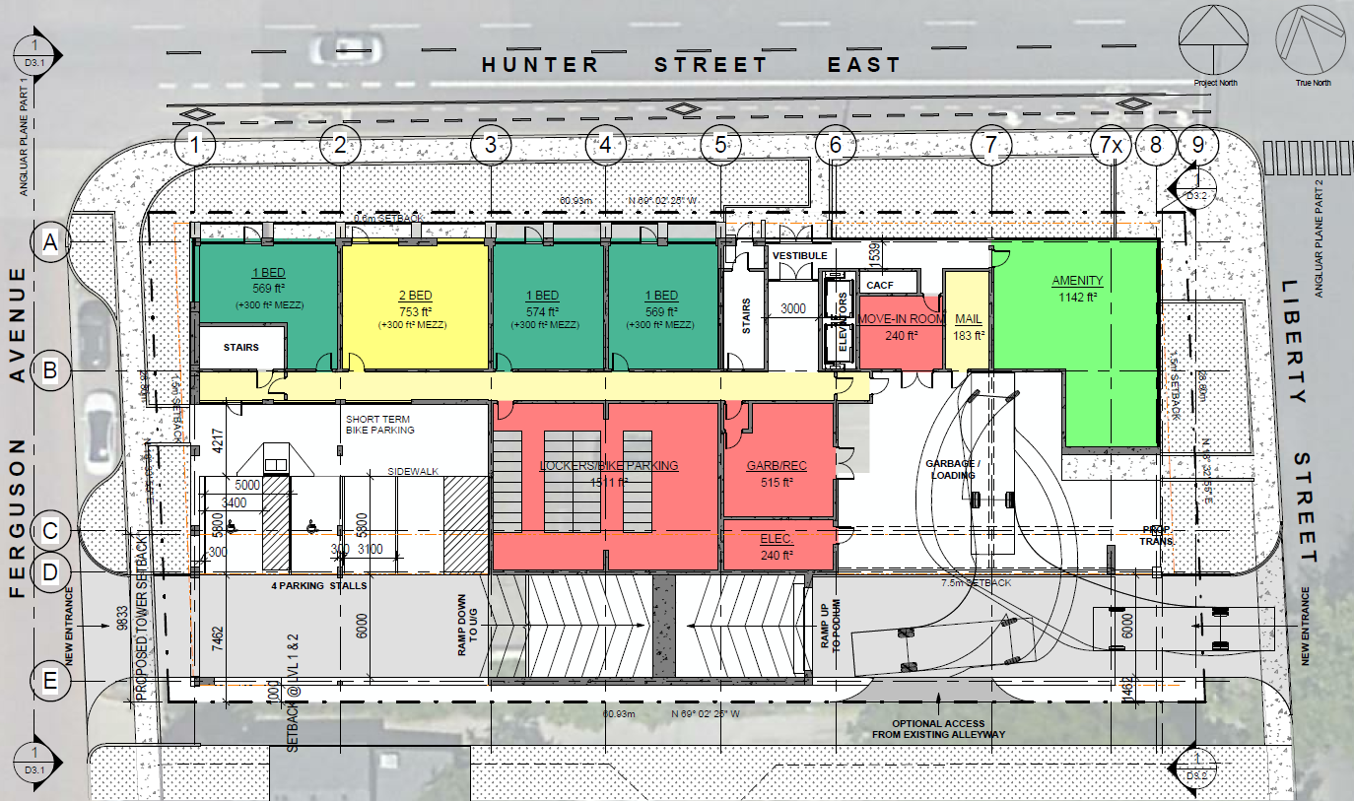
Proposed Concept Plan

Slide 7
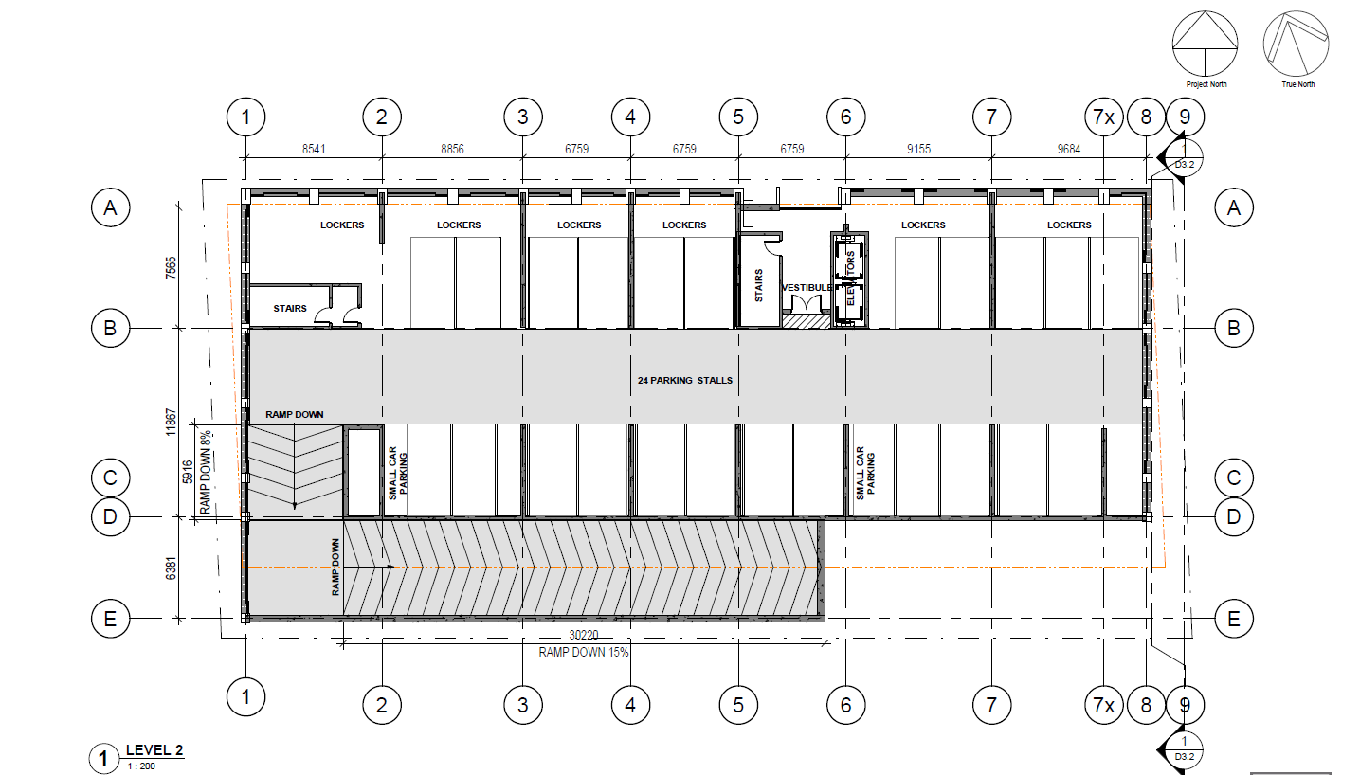
Parking Podium Floor Plan

Slide 8
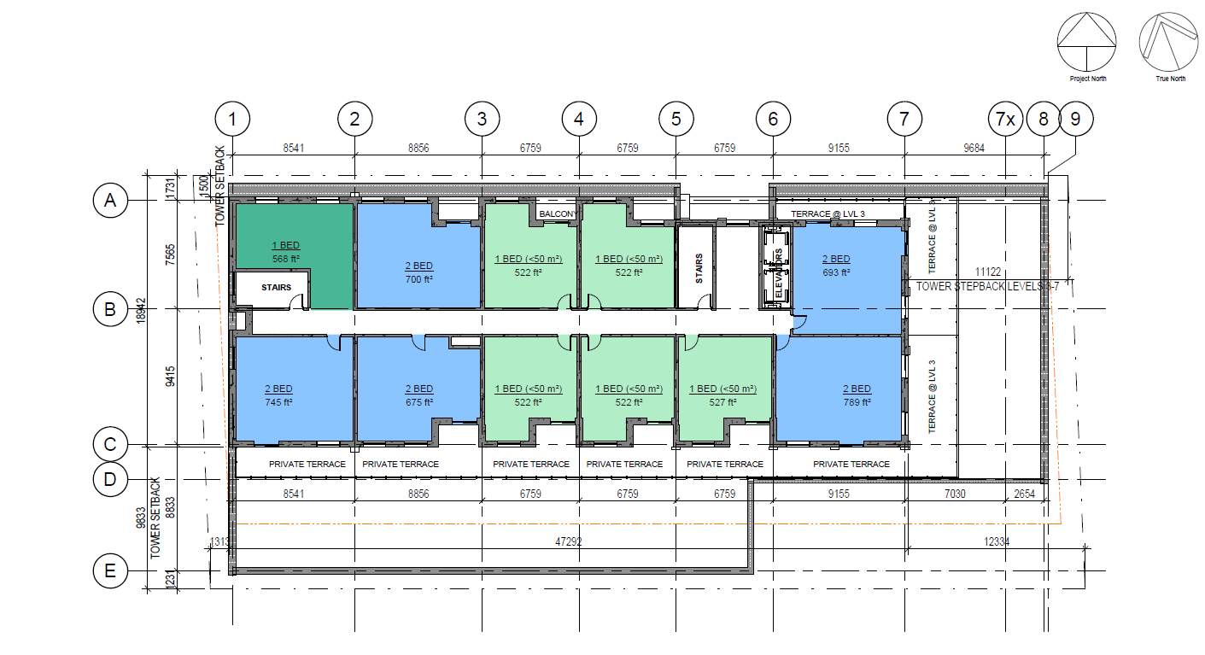
3rd-7th Storey Typical Floor Plan

Slide 9
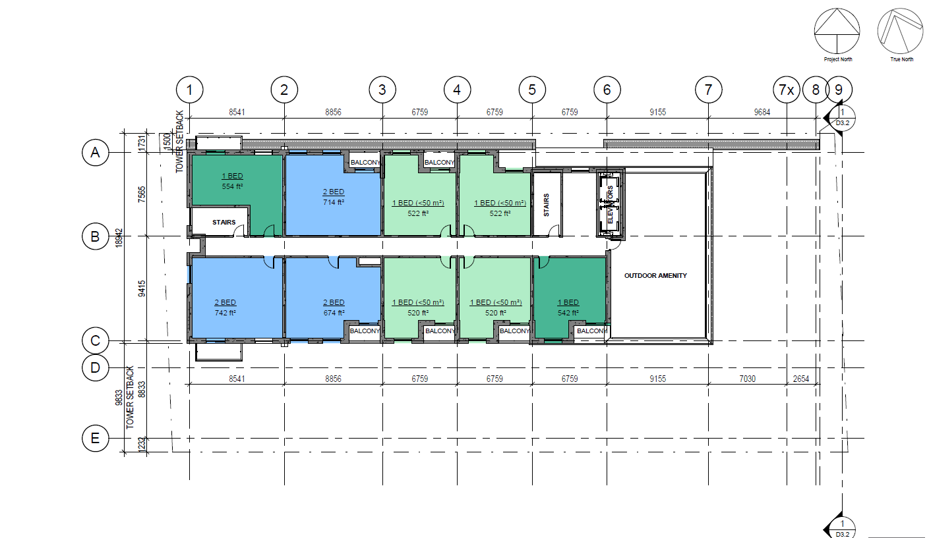
8th-12th Storey Typical Floor Plan

Slide 10
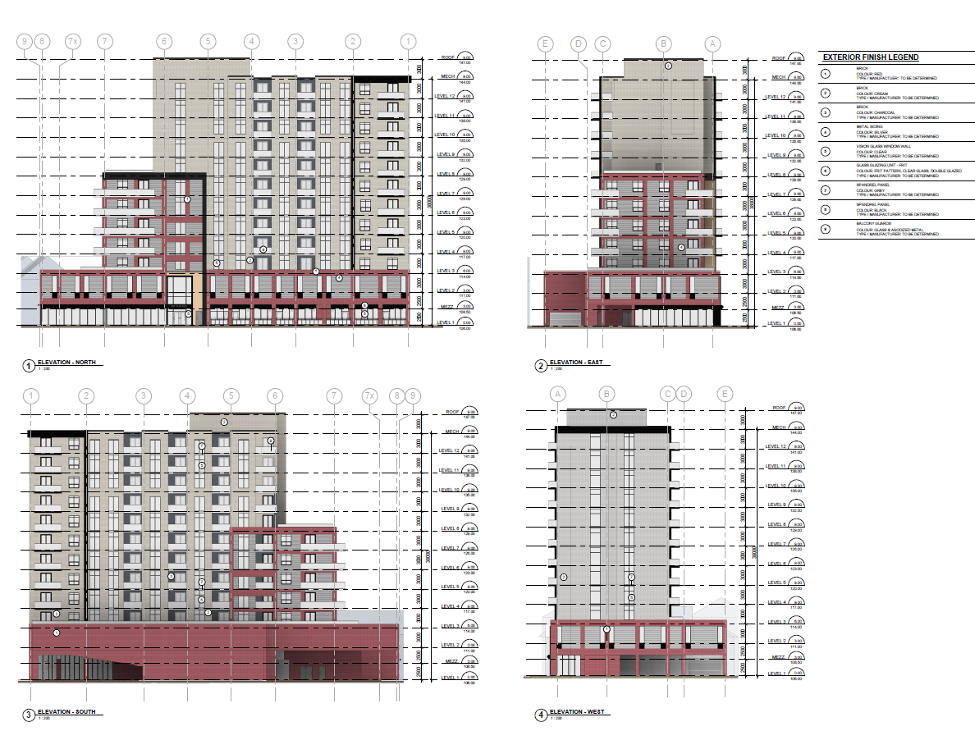
Elevations

Slide 11
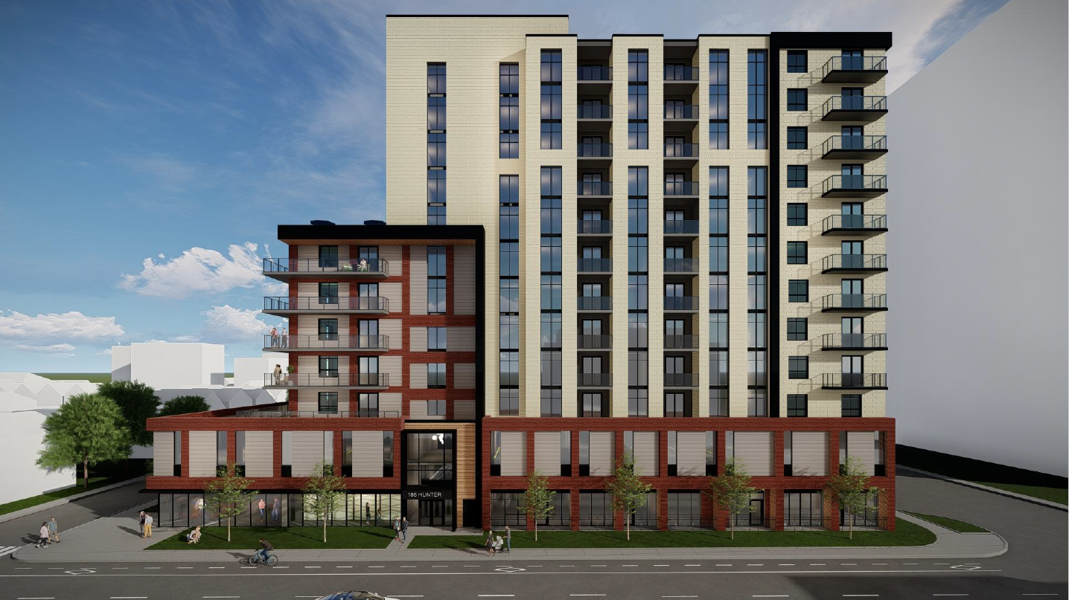
Project Renderings

Slide 12
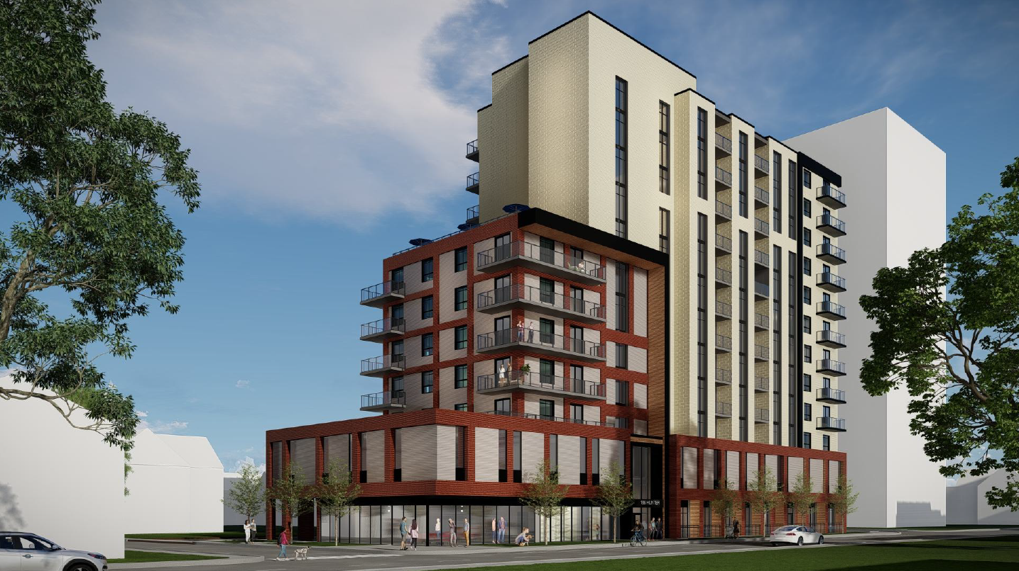
Project Renderings

Slide 13
Project Renderings

Slide 14
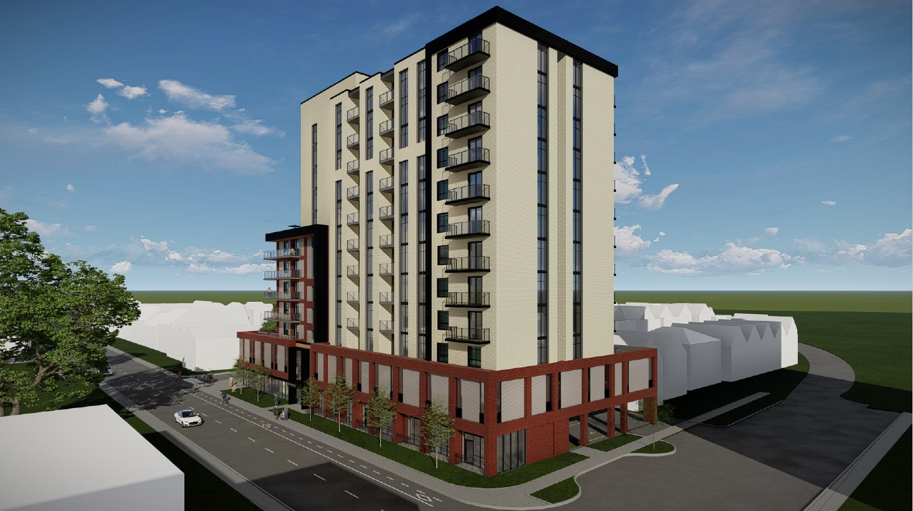
Project Renderings

Slide 15
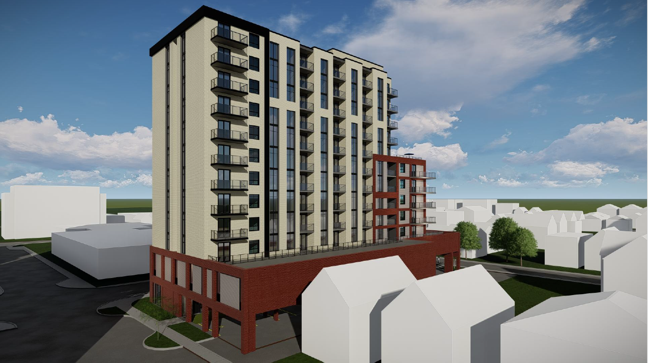
Project Renderings

Slide 16
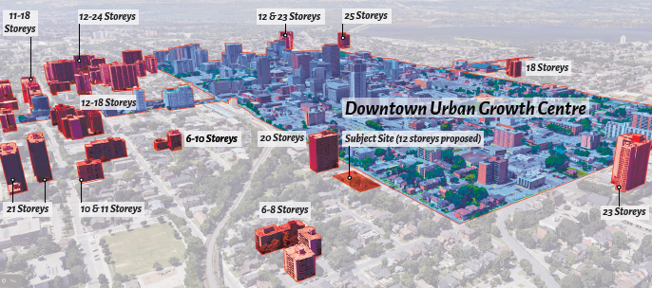
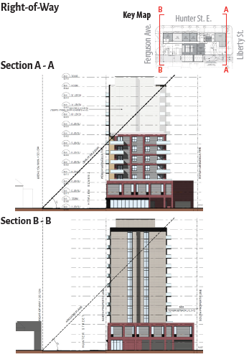
Height & Angular Plane
Proposed 12-storey height is characteristic of other multiple dwellings surrounding the Downtown Urban Growth Centre
Though prescribed angular planes are not met, the proposed massing design is sympathetic to surrounding properties

Slide 17
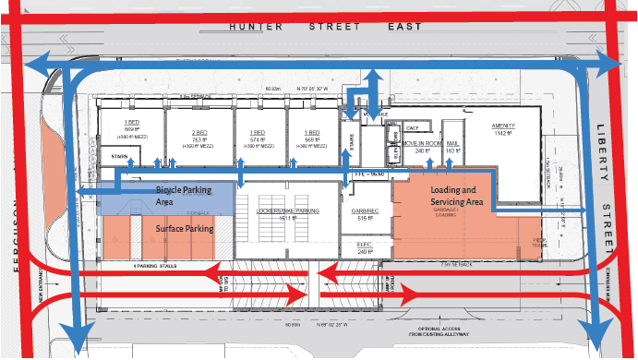
Site Circulation

Slide 18
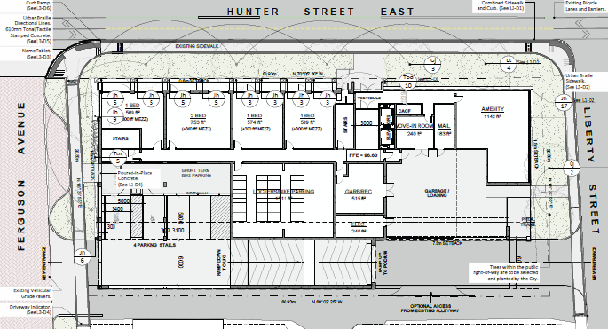
Landscaping

Slide 19
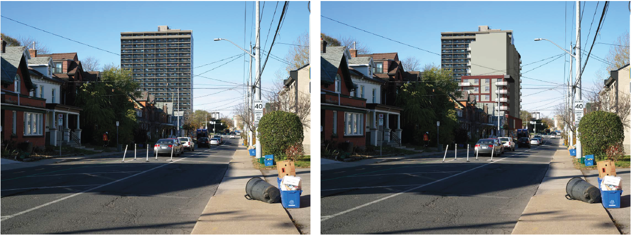
Visual Impact Assessment
Current condition looking west on Hunter Street East
Proposed condition looking west on Hunter Street East

Slide 20
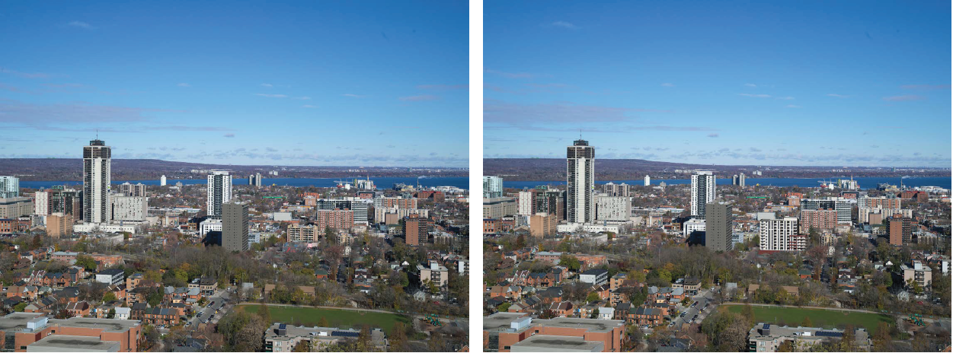
Visual Impact Assessment
Current condition looking north from Sam Lawrence Park
(Top of Escarpment)
Proposed condition looking north from Sam Lawrence Park
(Top of Escarpment)

Slide 21
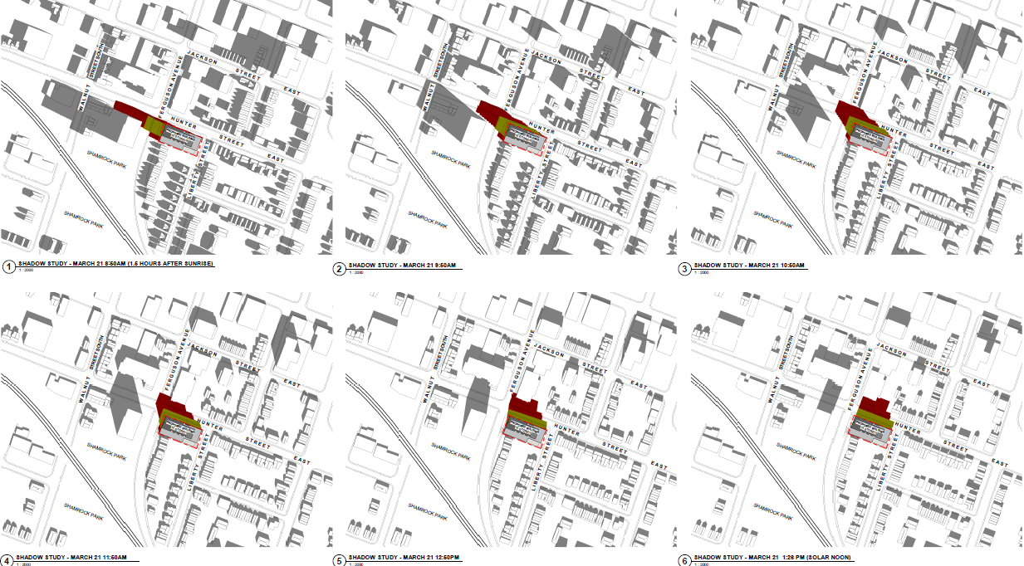
Sun/Shadow Study
Shadows cast by the tower design do not result in significant adverse impacts as adjacent residential amenity areas, public open space, public sidewalks, and the face of residential buildings are not subject to prolonged shadows.
March 21st Resulting Shadows
8:50am – 1:28pm

Slide 22
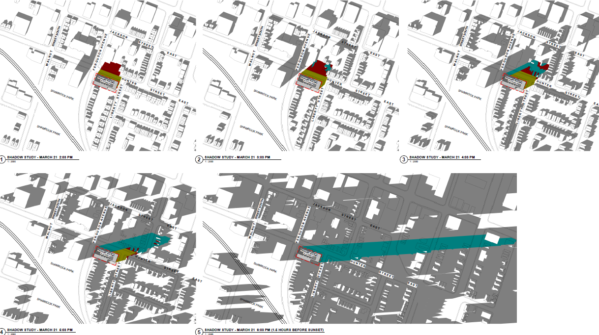
Sun/Shadow Study
March 21st Resulting Shadows
2:03pm – 6:03pm

Slide 23
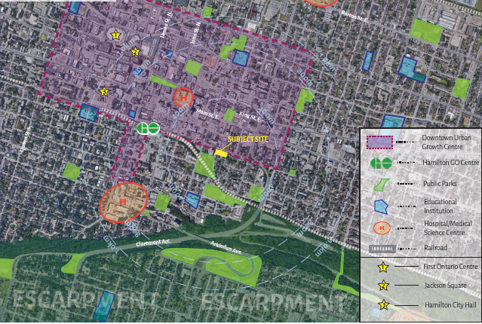
Surrounding Amenity Areas

